Slide 1
PE3:CC & NLP Lab
4-Watson Personality Insights - Suggest the user suitable books or movies, based on his personality traits. Download a speech or blog of the user and use IBM Watson personality insights service to predict which books or movies he would like. (Pre-requisite: Group assignment to study and discuss the personality models – Big Five, Needs and Values, explained on IBM Watson website)

Slide 2
The IBM Watson™ Personality Insights service
Enables applications to derive insights from social media, enterprise data, or other digital communications.
The service uses linguistic analytics to infer individuals' intrinsic personality characteristics,
It includes Big Five, Needs, and Values, from digital communications such as email, text messages, tweets, and forum posts.
Service uses to describe personality characteristics

Slide 3
The IBM Watson™ Personality Insights service
A more reasonable approach for personality-based matching is to use the Watson personality insights (PI) service.
By mapping the user’s personality to the 50+ dimensions measured by Watson PI avoid the pitfalls of explicitly naming personality or style preferences.
By doing the same on the products and brands in an e-commerce site, it is possible to match the “style” of a consumer with the style of products and brands, using a simple distance metric.
As long as the calculated profiles are accurate, this method constitutes a new way to drive product recommendations, and uses data that has not been leveraged in the past.

Slide 4
Recommendation
Generate sufficient descriptive text for brands and/or products
Calculate the respective personality profile using the Watson Personality Insights API.
Calculate the personality profile for the web site visitor using equally accurate descriptive text (to minimize the burden on the user to enter rich descriptive text we can use a Facebook or Twitter feed).
Calculate the “distance” between the consumer profile and the profiles of brands or products. For simplicity, one can use the Euclidean distance of individual personality traits.
Rank of recommended brands or products based on the distance metric.

Slide 5
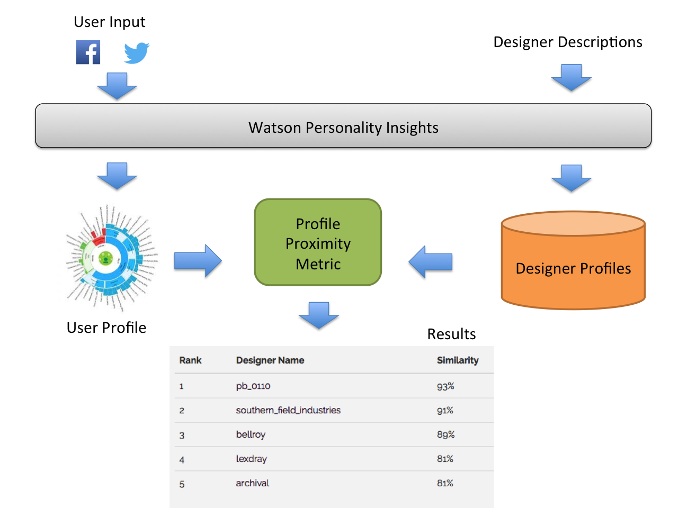
Personality Insights

Slide 6
Advantages
The consumer does not have to explicitly state their likes and preferences
The estimation of likeness is based on a new metric that approximates unquantifiable properties of the human personality such as “style”, “mood”, “emotion”, and others.
The effectiveness of these metrics is still under evaluation, and of course, several iterations of tuning the distance metrics and the corresponding heuristics are needed.

Slide 7
Personality Models
The Personality Insights service is based on the psychology of language in combination with data analytics algorithms.
The service analyzes the content that you send and returns a personality profile for the author of the input.
The service infers personality characteristics based on three models:
Big Five Model
Needs
Values

Slide 8
Big Five Model
Big Five personality characteristics represent the most widely used model for generally describing how a person engages with the world. The model includes five primary dimensions:
Agreeableness is a person's tendency to be compassionate and cooperative toward others.
Conscientiousness is a person's tendency to act in an organized or thoughtful way.
Extraversion is a person's tendency to seek stimulation in the company of others.
Emotional range, also referred to as Neuroticism or Natural reactions, is the extent to which a person's emotions are sensitive to the person's environment.
Openness is the extent to which a person is open to experiencing different activities.
Each of these top-level dimensions has six facets that further characterize an individual according to the dimension.

Slide 9
Needs
Needs describe which aspects of a product resonate with a person. The model includes twelve characteristic needs.
Needs describe at a high level those aspects of a product that are likely to resonate with the author of the input text. It describes the twelve needs that the service evaluates.
A score above the mean of 0.5 indicates a greater than average tendency for a characteristic. A score at or above 0.75 indicates readily discernible aspects of the characteristic; such scores are considered high

Slide 10
Needs
Need | Individuals who score high...
Excitement | Want to get out there and live life, have upbeat emotions, and want to have fun.
Harmony | Appreciate other people, their viewpoints, and their feelings.
Curiosity | Have a desire to discover, find out, and grow.
Ideal | Desire perfection and a sense of community.
Closeness | Relish being connected to family and setting up a home.
Self-expression | Enjoy discovering and asserting their own identities.
Liberty | Have a desire for fashion and new things, as well as the need for escape.
Love | Enjoy social contact, whether one-to-one or one-to-many. Any brand that is involved in bringing people together taps this need.
Practicality | Have a desire to get the job done, a desire for skill and efficiency, which can include physical expression and experience.
Stability | Seek equivalence in the physical world. They favor the sensible, the tried and tested.
Challenge | Have an urge to achieve, to succeed, and to take on challenges.
Structure | Exhibit groundedness and a desire to hold things together. They need things to be well organized and under control.

Slide 11
Values
Values describe motivating factors that influence a person's decision making. The model includes five values.
Values describe motivating factors that influence the author's decision-making. The five values will shows that how the service infers.
A score above the mean of 0.5 indicates a greater than average tendency for a characteristic. A score at or above 0.75 indicates readily discernible aspects of the characteristic; such scores are considered high

Slide 12
5 Values
Value | Individuals who score high...
Self-transcendence / Helping others | Show concern for the welfare and interests of others.
Conservation / Tradition | Emphasize self-restriction, order, and resistance to change.
Hedonism / Taking pleasure in life | Seek pleasure and sensuous gratification for themselves.
Self-enhancement / Achieving success | Seek personal success for themselves.
Open to change / Excitement | Emphasize independent action, thought, and feeling, as well as a readiness for new experiences.

Slide 13
Profile Request
with open(join(dirname(__file__), './profile.json')) as profile_json:
profile = personality_insights.profile(
profile_json.read(),
'application/json',
content_type='application/json',
consumption_preferences=True,
raw_scores=True
).get_result()
print(json.dumps(profile, indent=2))

Slide 14
Profile Response
{
"word_count": 15223, "processed_language": "en",
"personality": [
{
"trait_id": "big5_openness",
"name": "Openness",
"category": "personality",
"percentile": 0.8011555009553,
"raw_score": 0.77565404255038,
"significant": true,
"children": [
{
"trait_id": "facet_adventurousness",
"name": "Adventurousness",
"category": "personality",
"percentile": 0.89755869047319,
"raw_score": 0.54990704031219,
"significant": true
} ] },

